Slide 1
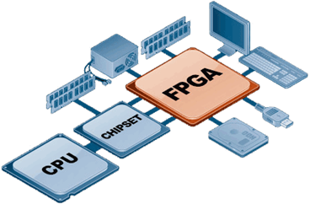
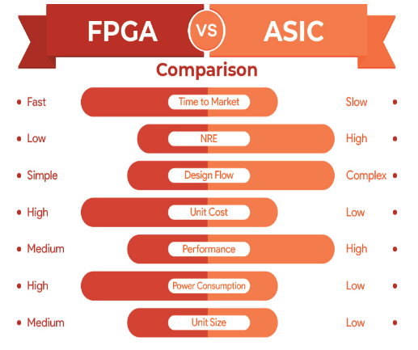
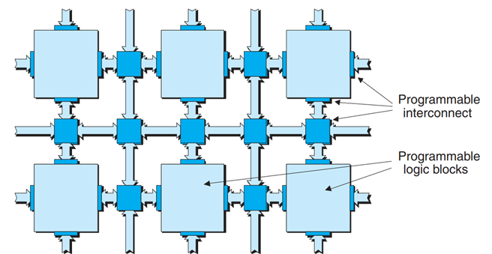
FPGA
A field-programmable gate array (FPGA The FPGA
configuration is generally specified using a hardware description language (HDL).
application-specific integrated circuit (ASIC) vs FPGA: Which one do you choose?

Slide 2
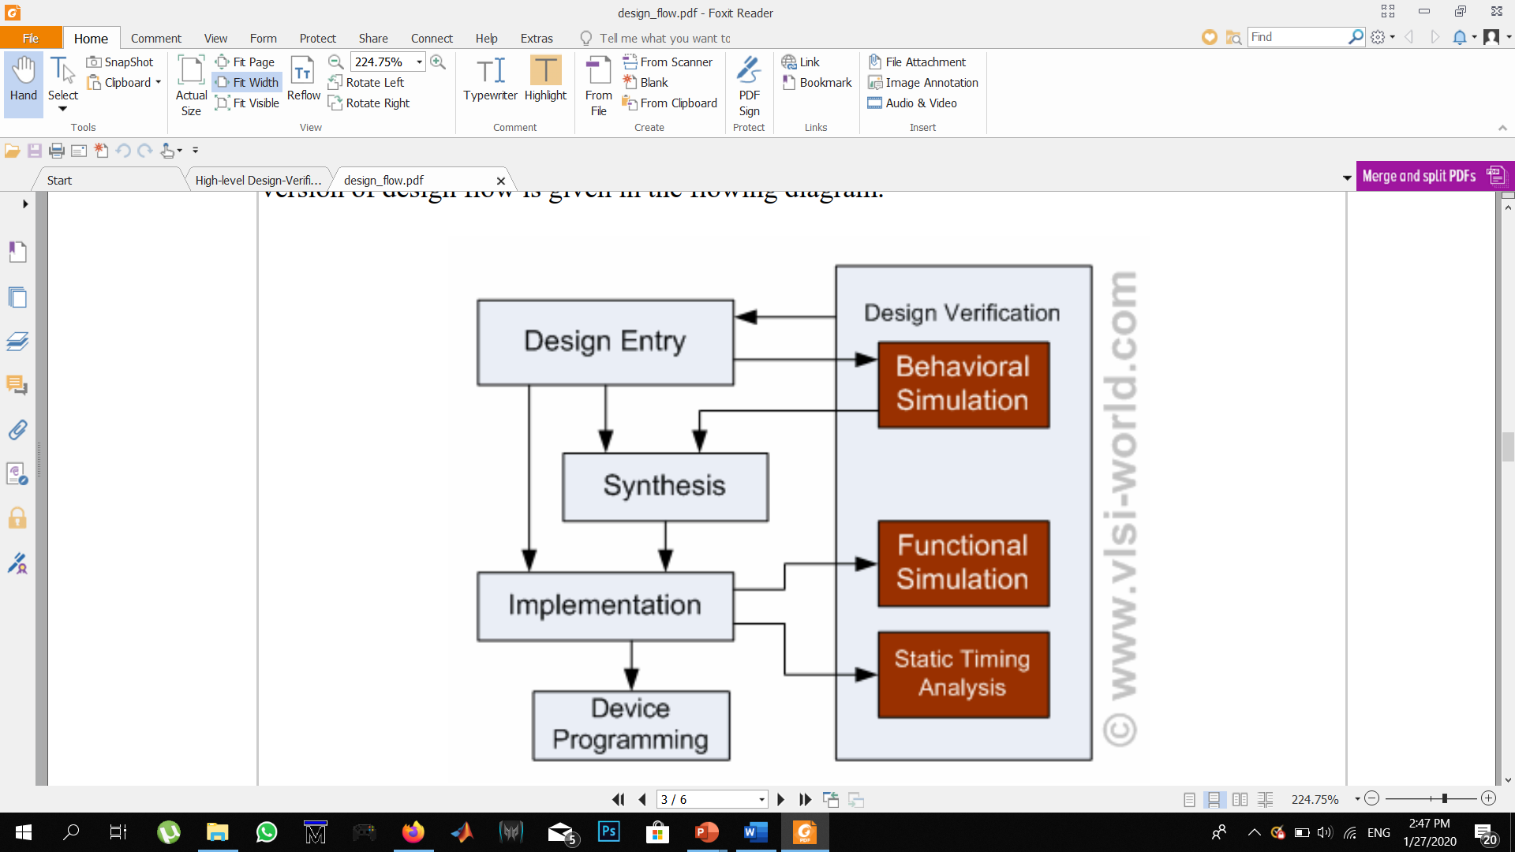
FPGA Design Flow
Entry:
- Schematic (Behavioral).
- HDL (Behavioral).
Synthesis:
- netlist.
- constrains.
Implementation:
- translate (Functional).
- mapping (Timing).
- placement& routing (Timing).
Device programing:
- Bit file.

